Slide 1
Be Up finance
Be Up finance

Slide 2


Overview
People like scrolling and games !!!
Interest in finance continues to grow annually !!!
Be Up finance

Slide 3



Solution
Artificial Intelligence
Mobile Application
Be Up finance

Slide 4




Product
ACADEMY
PROFILE
Earn rewards while gaining technical knowledge
NEWS
Manage your advancement and personal pursuits
Provide a financial perspective on global dynamics
Be Up finance

Slide 5


News
Scrolling, as everyone knows how to do !!!
It's more than just finance, it's about the world around us…
Be Up finance

Slide 6
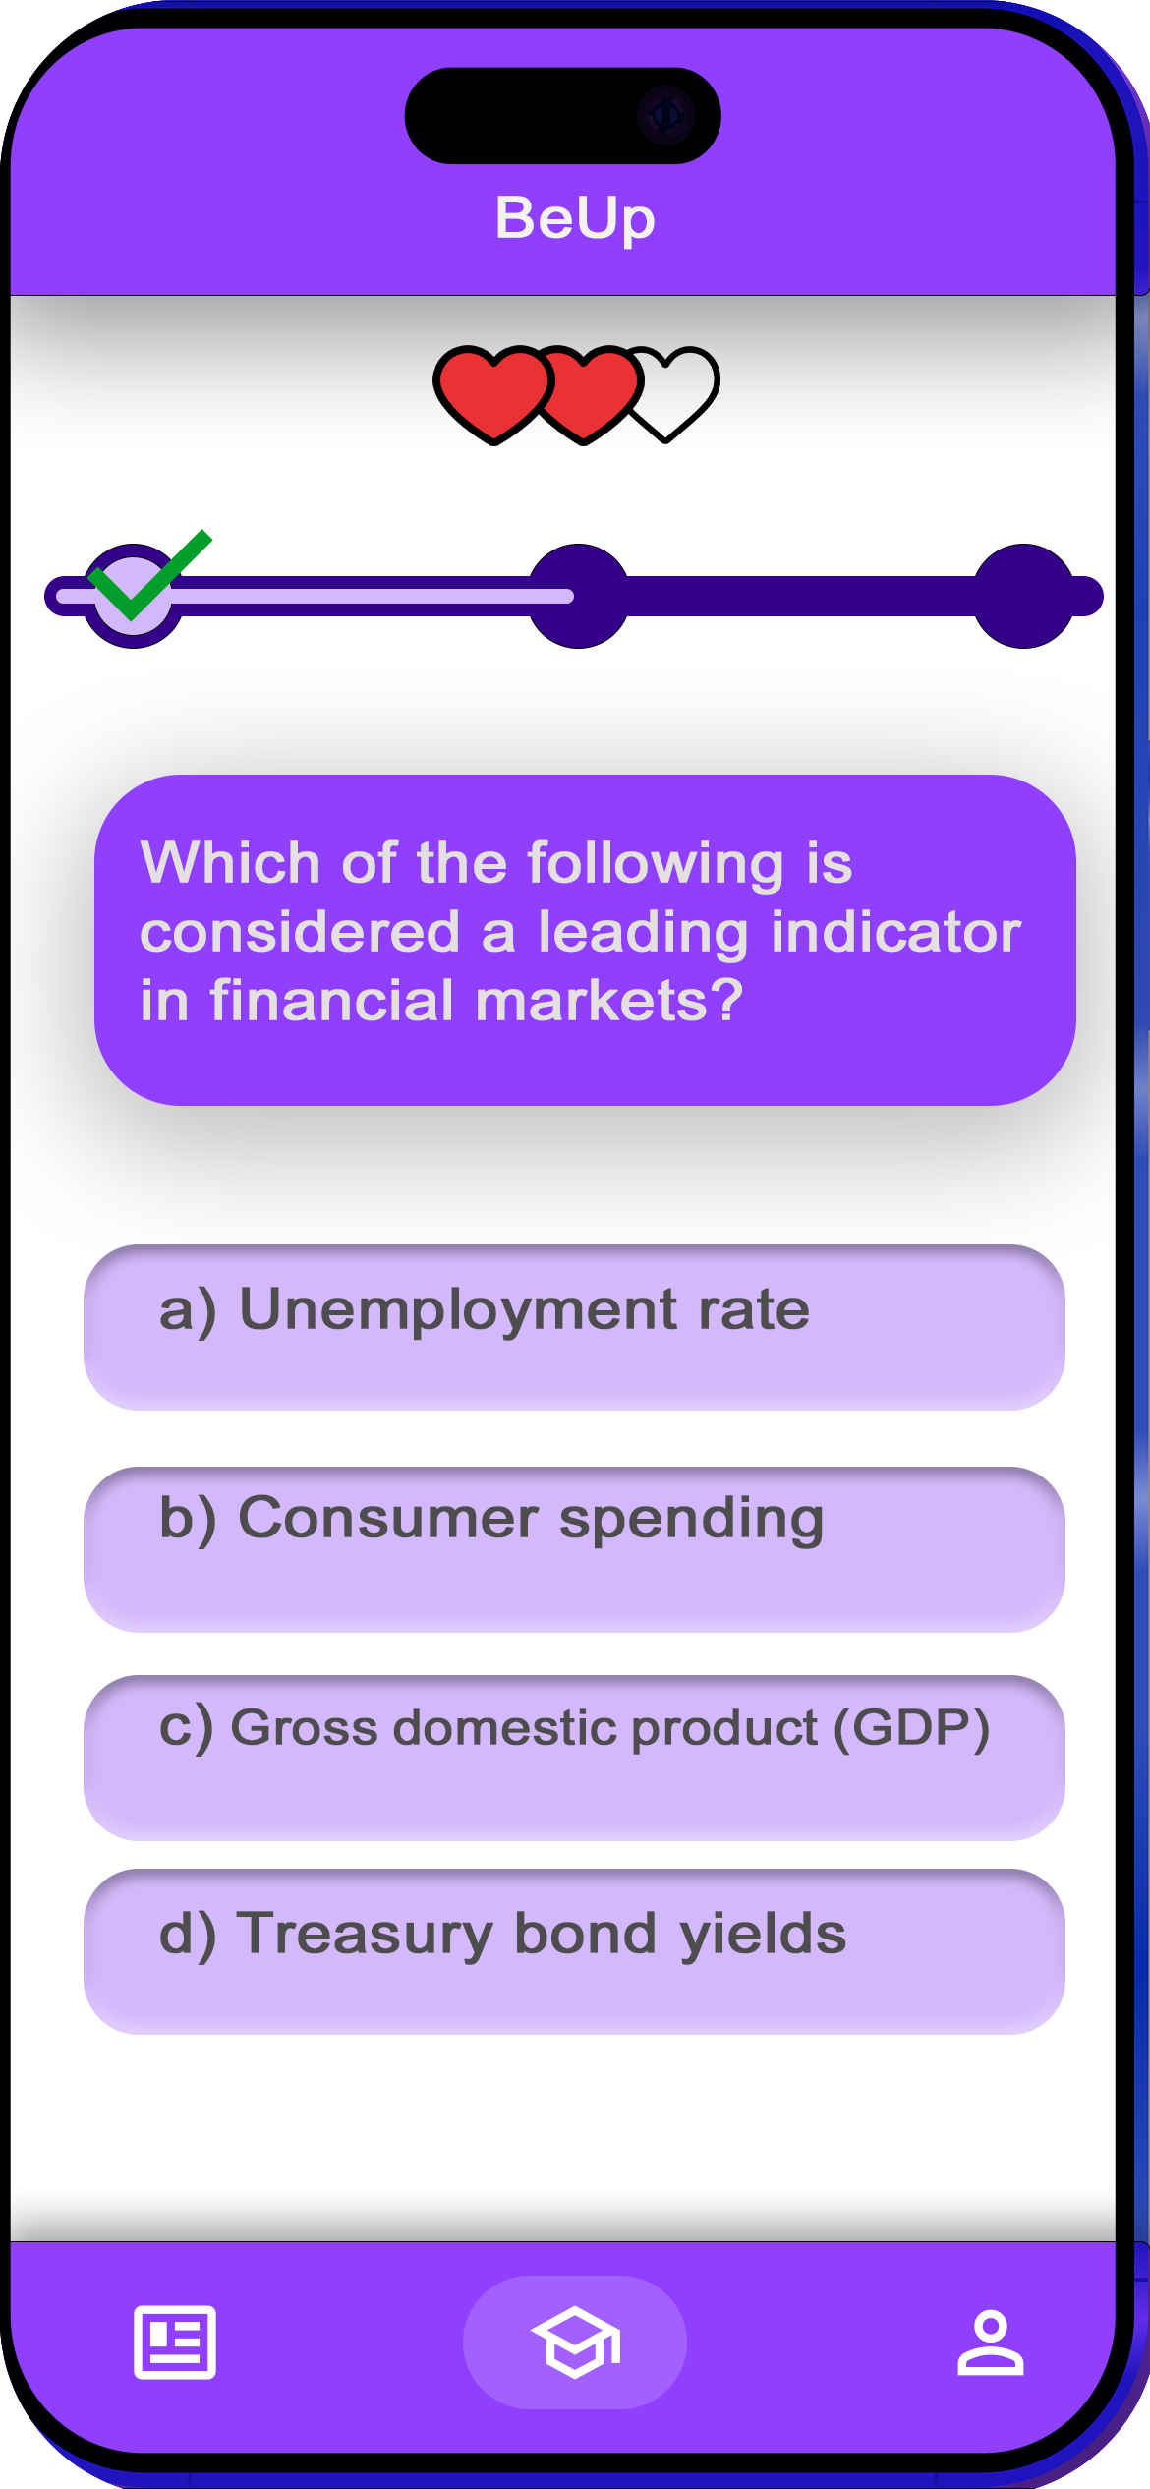
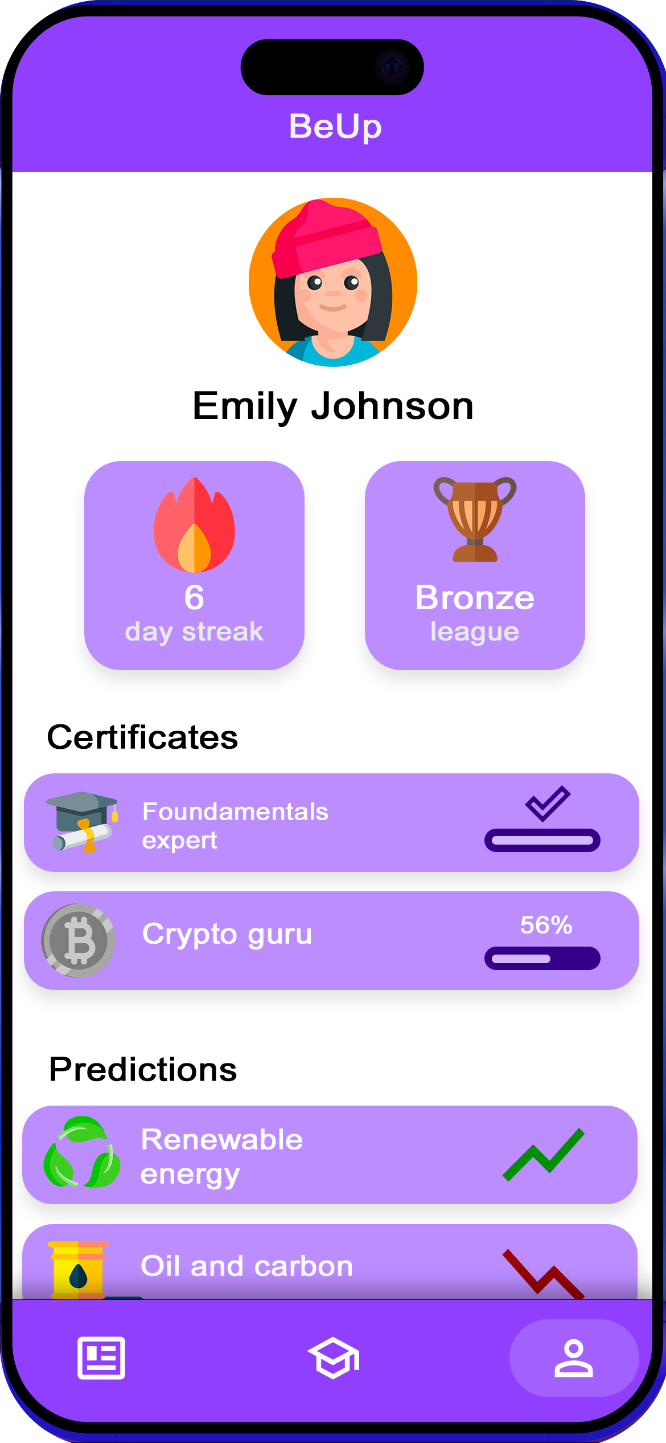
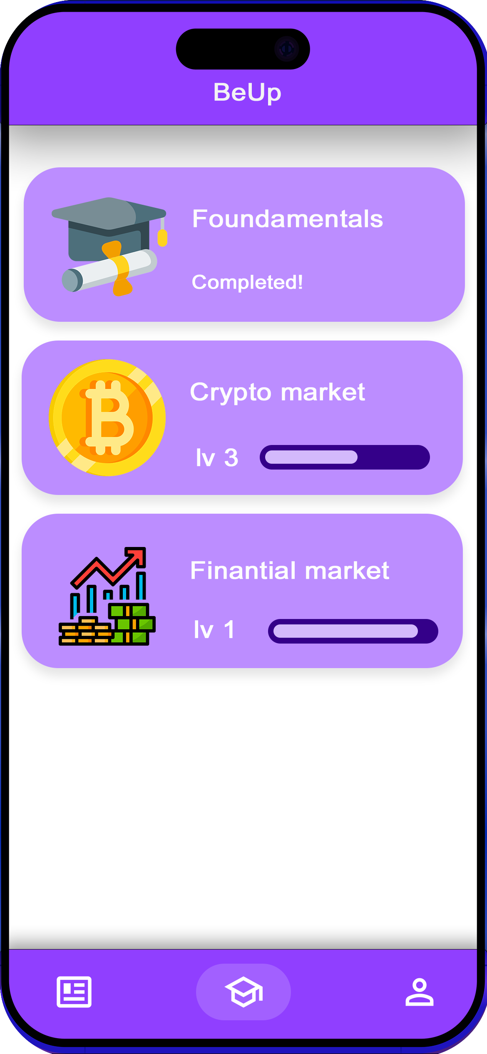

Academy
Muliples topics
Track your performance
Emily is doing well !!!
Interactive games
Be Up finance

Slide 7

LLMs
Impressive performance in text comprehension and article summarization
Increasing ability to process tokens
Be Up finance

Slide 8



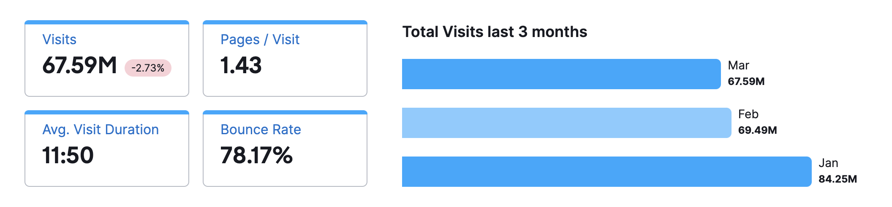

Market Validation
InvestiMate
2M+ downloads
Money maker
500k+ downloads
Learn: stock marketing
2M+ downloads
Be Up finance

Slide 9



Revenue
Advertising
showcase products and services to users, driving substantial revenue.
Premium subscription
exclusive access to advanced features and content, adding value for those seeking comprehensive financial education and global event updates
Partnerships
alliances with trading platforms enhance user experience and expand reach, offering real-money trading access and driving revenue growth
Be Up finance

Slide 10

Thank you for your attention
Be Up finance

